Slide 1
School of Computing Science and Engineering
Course Code : BTCS2401 Course Name: Computer Graphics
Transparency and Shadows
Name of the faculty: Suman Devi Program Name: B.Tech

Slide 2
Objective
School of Computing Science and Engineering
Course Code : BTCS2401 Course Name: Computer Graphics
Shadows
Shadow techniques
Projection shadows
Shadows volume
Shadow maps
Shadow textures
Transperency
Depth peeling
Name of the faculty: Suman Devi Program Name: B.Tech

Slide 3
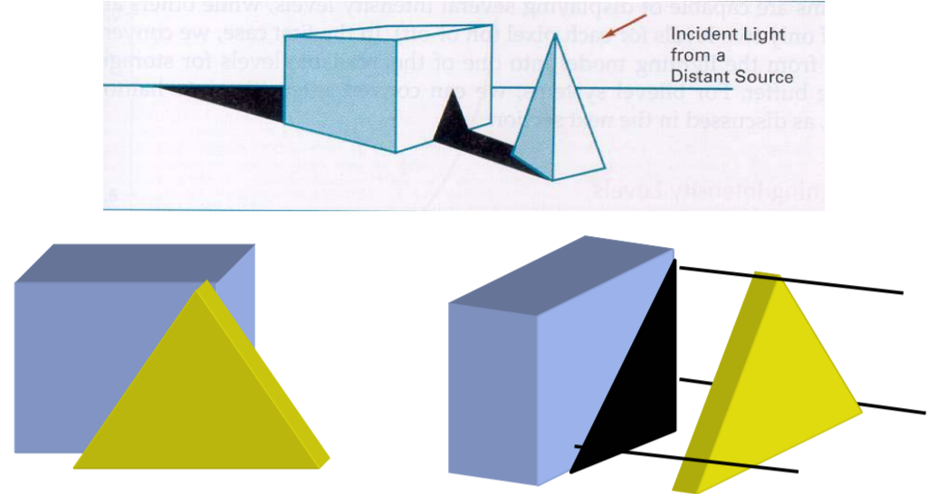
Shadows
School of Computing Science and Engineering
Course Code : BTCS2401 Course Name: Computer Graphics
• A shadow covers surfaces that are not “visible” by the light source while being visible by the viewer.
Name of the faculty: Suman Devi Program Name: B.Tech

Slide 4
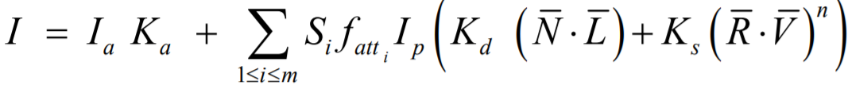
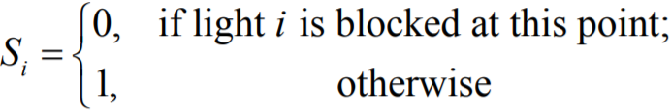
Shadows
School of Computing Science and Engineering
Course Code : BTCS2401 Course Name: Computer Graphics
Intuition: hidden surface detection and shadow generation are in practice the same problem
Illumination equation for m sources, and including attenuation and shadows:
Observation: ambient light is not affected by shadows and attenuation
Name of the faculty: Suman Devi Program Name: B.Tech

Slide 5
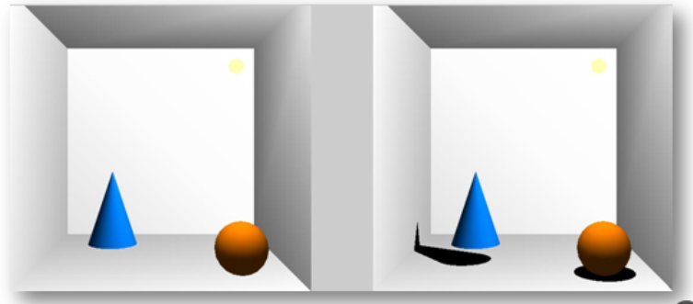
Shadow techniques
School of Computing Science and Engineering
Course Code : BTCS2401 Course Name: Computer Graphics
In illuminated scenes objects cast shadows on other objects
– Important visual cue for object positioning
– Scene without shadows doesn’t match reality
Name of the faculty: Suman Devi Program Name: B.Tech

Slide 6
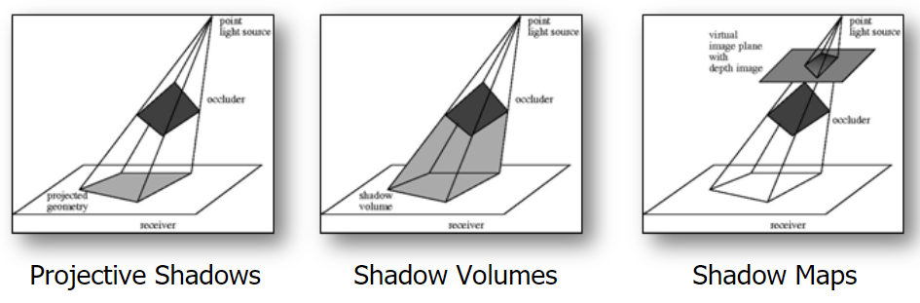
Shadow Techniques
School of Computing Science and Engineering
Course Code : BTCS2401 Course Name: Computer Graphics
Classification of shadow techniques
– How to account for interaction between light, shadow casters and shadowed objects
Name of the faculty: Suman Devi Program Name: B.Tech

Slide 7
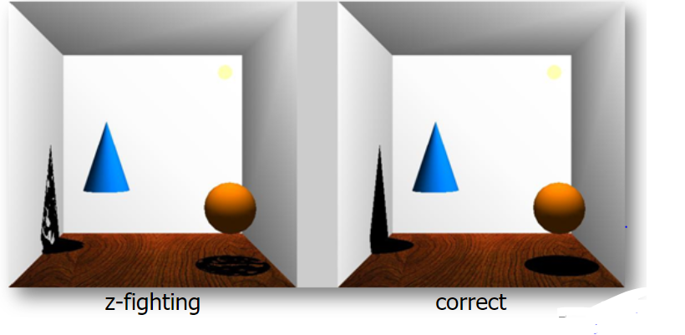
Projection Shadows
School of Computing Science and Engineering
Course Code : BTCS2401 Course Name: Computer Graphics
Problems of projective shadows Problems of projective shadows
– Z-Fighting: Projected object has “same” depth values as shadowed plane
Name of the faculty: Suman Devi Program Name: B.Tech

Slide 8
Projective Shadows
School of Computing Science and Engineering
Course Code : BTCS2401 Course Name: Computer Graphics
Problems of projective shadows
– In complex scenes multiple shadow projections are needed
Objects have to be rendered multiple times
– Need to find surfaces that are in shadow
– Only works well on planar surfaces
– For complex objects clipping has to be performed against every face
Name of the faculty: Suman Devi Program Name: B.Tech

Slide 9
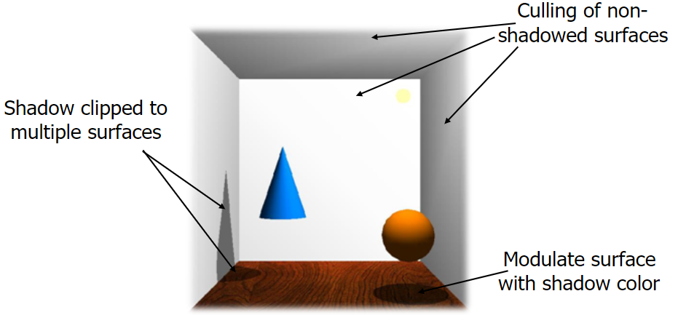
Projective Shadows
School of Computing Science and Engineering
Course Code : BTCS2401 Course Name: Computer Graphics
Projective shadows in complex scenes
Name of the faculty: Suman Devi Program Name: B.Tech

Slide 10
Shadow Volumes
School of Computing Science and Engineering
Course Code : BTCS2401 Course Name: Computer Graphics
– Relies on a geometric representation of the spatial region that is shadowed by an object
– Shadow polyhedra is generated in advance
– Shadow algorithm now involves the stencil test and the depth test
Name of the faculty: Suman Devi Program Name: B.Tech

Slide 11
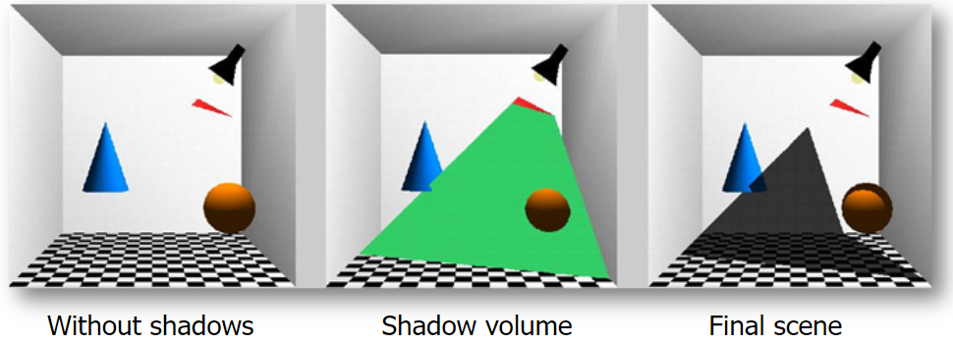
Shadow Volumes
School of Computing Science and Engineering
Course Code : BTCS2401 Course Name: Computer Graphics
Shadow volume geometry
Name of the faculty: Suman Devi Program Name: B.Tech

Slide 12
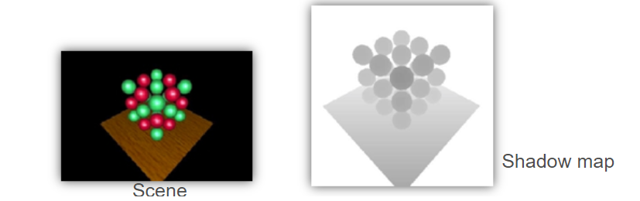
Shadow Maps
School of Computing Science and Engineering
Course Code : BTCS2401 Course Name: Computer Graphics
– a two-pass approach
– Render the scene from the light source position using a virtual image plane
– Grab the depth buffer and store it as a shadow map
– Before rendering a fragment from the camera
Project it towards the light source onto the shadow map
Discard fragment if distance to light source is less than entry in shadow map
Name of the faculty: Suman Devi Program Name: B.Tech

Slide 13
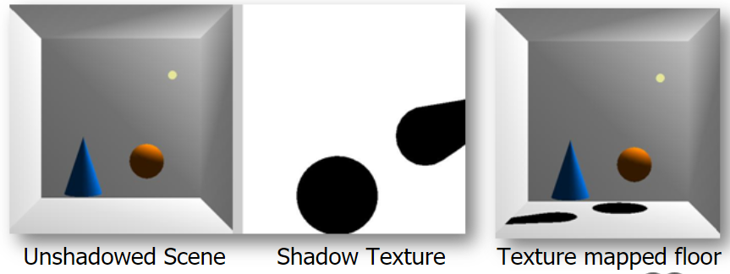
Shadow Textures
School of Computing Science and Engineering
Course Code : BTCS2401 Course Name: Computer Graphics
– Render shadow on the receiver and load it as shadow texture
Light source and shadow object
Name of the faculty: Suman Devi Program Name: B.Tech

Slide 14
Shadow Techniques
School of Computing Science and Engineering
Course Code : BTCS2401 Course Name: Computer Graphics
Soft shadows
– Similar to motion blur
– Assume area light source
Jitter light position within area
Render from jittered positions
Combine results in the accumulation buffer
Name of the faculty: Suman Devi Program Name: B.Tech

Slide 15
Transparency
School of Computing Science and Engineering
Course Code : BTCS2401 Course Name: Computer Graphics
How to handle non-opaque (semi-transparent) objects
– Multiple fragments contribute to a pixel
– Visibility order of fragments is important
– Depth buffer can be used for hidden surface removal but not for semi-transparent objects
Name of the faculty: Suman Devi Program Name: B.Tech

Slide 16
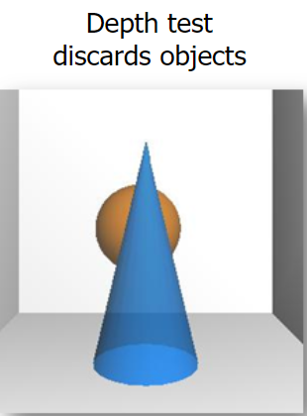
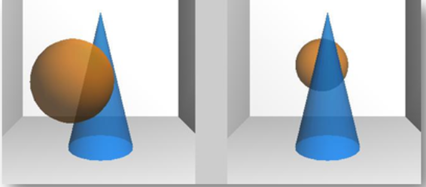
Transparency
School of Computing Science and Engineering
Course Code : BTCS2401 Course Name: Computer Graphics
See through objects
Object order affects final color
Blending non commutative
α1 C 1 + (1- α1 ) α0 C 0 ≠ α 0 C 0 + (1- α0 ) α1 C 1
Name of the faculty: Suman Devi Program Name: B.Tech

Slide 17
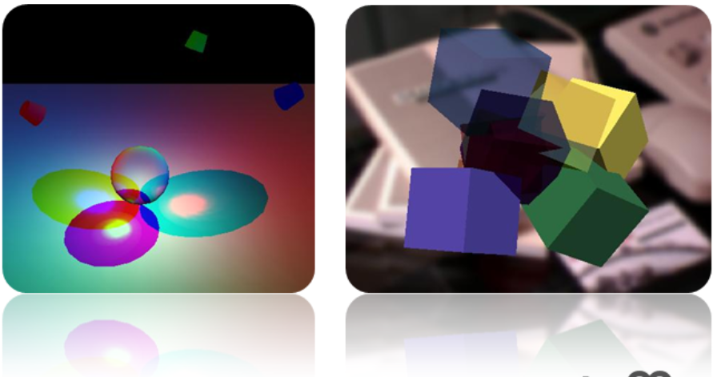
Transparency
School of Computing Science and Engineering
Course Code : BTCS2401 Course Name: Computer Graphics
Correct transparency by sorting and alpha-blending
Name of the faculty: Suman Devi Program Name: B.Tech

Slide 18
Depth Peeling
School of Computing Science and Engineering
Course Code : BTCS2401 Course Name: Computer Graphics
Recall: standard depth test gives nearest fragment at each pixel without imposing any order
But: there is also a second, third … fragment, depth test does not provide a means to render the nth nearest surface.
Depth peeling solves this problem:
– With n passes over a scene, n layers deeper into the scene are generated
– E.g. with 2 passes, the nearest and second nearest surfaces are extracted
– Both the depth and RGBA information is obtained for each layer
Name of the faculty: Suman Devi Program Name: B.Tech

Slide 19
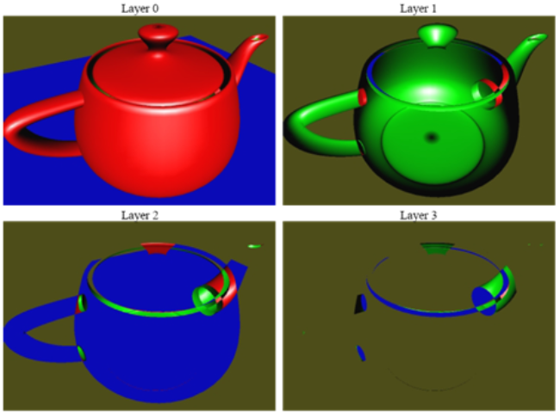
Depth Peeling
School of Computing Science and Engineering
Course Code : BTCS2401 Course Name: Computer Graphics
Example:
Name of the faculty: Suman Devi Program Name: B.Tech

Slide 20
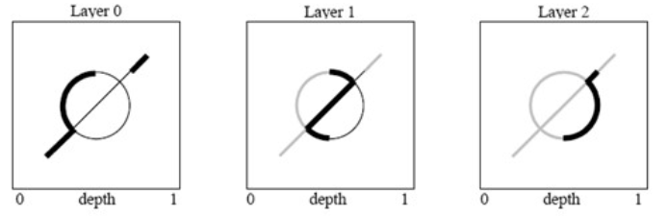
Depth Peeling
School of Computing Science and Engineering
Course Code : BTCS2401 Course Name: Computer Graphics
The method peels different depth layers in front- to-back order
Drawback: as many rendering passes as objects depth complexity (maximum number of surface points mapping to one fragment)
Name of the faculty: Suman Devi Program Name: B.Tech

Slide 21
Summary
School of Computing Science and Engineering
Course Code : BTCS2401 Course Name: Computer Graphics
In this PPT we have discussed about shadows and transparency in depth:
1. Shadows
Its techniques(projection shadows, shadows volume, shadow maps)
Its texture
2. Transperency
Techniques
Depth peeling
Name of the faculty: Suman Devi Program Name: B.Tech

Slide 22
School of Computing Science and Engineering
Course Code : BTCS2401 Course Name: Computer Graphics
Reference :
1 . Donald Hearn and M Pauline Baker, “Computer Graphics C Version”, Pearson Education, India; 2 edition 2002.
2. Computer Graphics Principles and Practice, Second Edition in C, James D.Foley, Andries Van Dam, Steven K.Feiner, JhonF.Hughes, Addison Wesley, Third Edition, 2014.
3. Steven Harrington, “Computer Graphics: A Programming Approach” , McGraw-Hill Inc.,US; 2nd Revised edition, 1983.
4. David Rogers, “Procedural Elements of Computer Graphics”, McGraw Hill Education; 2 edition, 2017.
Name of the Faculty: Suman Devi Program Name: B.Tech

Slide 23
School of Computing Science and Engineering
Course Code : BTCS2401 Course Name: Computer Graphics
Thank you!
Name of the Faculty: Suman Devi Program Name: B.Tech

